Slide 1

An Intelligent System for Automatic Grammar Error Detection and Correction Based on Rule-Based and Transformer Algorithms
DSA0308-Natural Language Processing
Supervisor
Presented by:
B.V.Chaitanya(192425376)
T.Megha harsha(192424389)
K.Yaswanth(192425393)
R.Kalyan Kumar Reddy (192472274)
M.Jagadeesh(192472333)
SIMATS Engineering
Kumaragurubaran T
SIMATS Engineering
1

Slide 2
Introduction
Grammar error detection and correction plays a vital role in improving written communication quality.
Automated systems assist students, professionals, and content creators in producing error-free text.
Traditional rule-based methods provide structured linguistic validation.
Transformer models enhance contextual understanding and correction accuracy.

Slide 3
Literature Review
S.NO | Title | Methodology | Limitations
1 | Preposition Error Correction – Chodorow et al. (2024) | Rule-based grammar rules combined with statistical modeling | Limited to specific grammatical errors and domain dependent
2 | CoNLL-2014 Shared Task – Ng et al. (2024) | Statistical Machine Translation | Poor contextual understanding
3 | BERT Model – Devlin et al. (2025) | Transformer-based contextual model | Needs large data & high computation
4 | Neural GEC with FST – Lichtarge et al. (2023) | Neural transformer model integrated with linguistic constraints | High computational cost and possible over-correction

Slide 4
Problem Statement
Existing grammar checking systems either rely solely on rigid rules or complex deep learning models.
Rule-based systems lack contextual flexibility.
Transformer models require high computational resources and large datasets.
There is a need for a hybrid system combining accuracy and efficiency.

Slide 5
Objectives
To develop a rule-based grammar checking module.
To implement a transformer-based grammar correction module.
To integrate both modules into a hybrid framework.
To evaluate system performance using standard metrics.

Slide 6
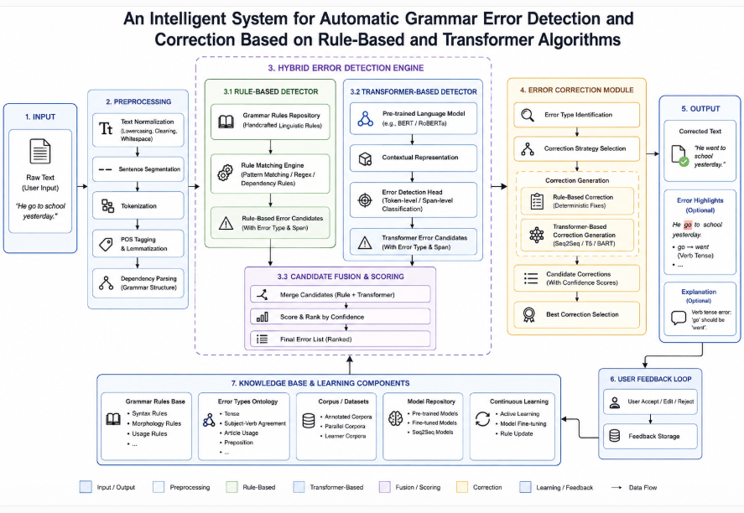
Architecture Diagram

Slide 7
Module 1: Text Input & Preprocessing
Receive text input from the user in the form of typed text or uploaded files.
Perform basic preprocessing to eliminate unwanted symbols, extra spaces, and formatting inconsistencies.
Identify sentence boundaries to organize the text for efficient analysis.
Break each sentence into individual words and standardize the text for further processing.
Produce a well-structured and processed text dataset that is ready for grammar error detection and correction.

Slide 8
Module 2 : Rule-Based Grammar Error Detection
Apply predefined grammar rules to identify errors in the input text.
Detect common grammatical mistakes such as subject–verb agreement, tense, punctuation, and article usage.
Compare sentence structures with grammatical patterns to locate incorrect word arrangements.
Identify and highlight grammar errors by specifying their exact positions in the text. Generate a detailed list of detected grammar errors for correction in the next module.

Slide 9
Module 3 : Transformer-Based Grammar Correction
Process the detected grammar errors using a transformer-based language model.
Generate grammatically correct sentences while preserving the original meaning of the text.
Correct errors related to grammar, word choice, sentence structure, and punctuation.
Improve the fluency and readability of the corrected text using contextual understanding.
Produce an accurate and refined version of the input text for final output.

Slide 10
Module 4 : Hybrid Integration & Error Resolution
Integrate the outputs of the rule-based and transformer-based approaches into a unified correction process.
Resolve conflicts between rule-based detections and transformer-generated corrections.
Validate the corrected text to ensure grammatical consistency and accuracy. Minimize false corrections by selecting the most appropriate correction based on predefined rules and contextual understanding.
Generate a final error-free version of the text with improved grammar, clarity, and readability.

Slide 11
Module 5 : Performance Evaluation & User Interface
Evaluate the system by measuring grammar detection and correction accuracy.
Compare the original text with the corrected output to assess the quality of corrections.
Display detected errors and suggested corrections through a simple and user-friendly interface.
Allow users to review, accept, or modify the suggested grammar corrections. Generate the final corrected text along with performance metrics and a summary of detected errors.

Slide 12
Conclusion
The system effectively detects and corrects grammar errors using a combination of rule-based and transformer-based approaches.
Transformer algorithms enhance accuracy by understanding context, while rule-based methods ensure structural correctness.
The approach improves writing quality and can be extended to support multiple languages and real-time applications.

Slide 13
Future Enhancements
Integrate advanced transformer models for better contextual understanding
Support grammar correction for multiple languages
Develop real-time grammar correction in text editors
Improve evaluation with larger and more diverse datas

Slide 14
Refrences
Qorib, M. R., Aji, A. F., & Ng, H. T. (2024). Efficient and Interpretable Grammatical Error Correction with Mixture of Experts. EMNLP.
Zhang, Y., Kamigaito, H., & Okumura, M. (2023). Bidirectional Transformer Reranker for Grammatical Error Correction. ACL Findings.
Tudose, M., Ruseti, S., & Dascalu, M. (2025). Two-Phased Grammatical Error Correction System. Information Journal.
Hwang, H. (2025). Evaluating Transformer-Based Grammatical Error Correction Systems. Language Testing in Asia.

Slide 15


